Slide 1


Book recommendation system
team members :
Ananya biswas
Nahadha rafeek
Shaik shoeb ahmed
Samir suresh Gadkari
Shivprasad jadhav
Abhishek kumar sahu ere
Pali satya sai mani sri harsa
Mentor’s name : snehal Shinde

Slide 2
Business objectives :
Generates the features from the datasets and use them to recommend the book accordingly to the users.

Slide 3

Project flow
Collection Of Data
Business Understanding
Exploratory Data Analysis(EDA)
Deployment
Model Building

Slide 4


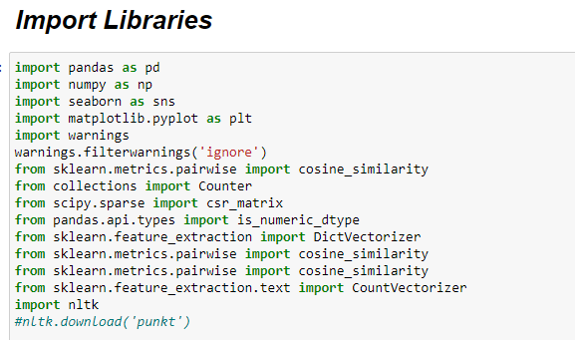
Import Libraries

Slide 5
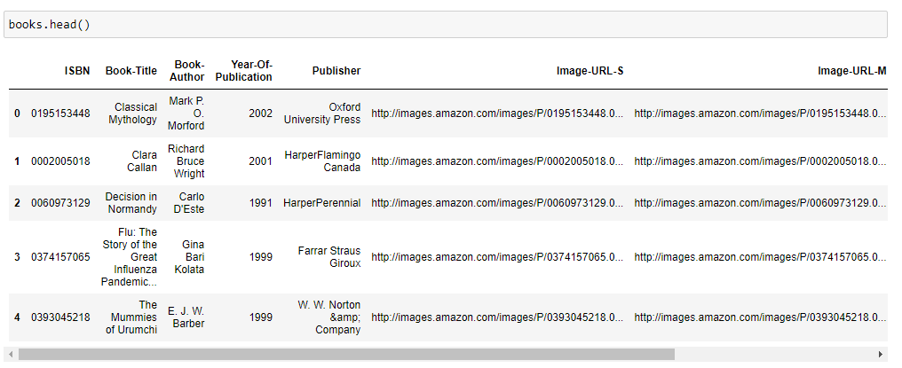
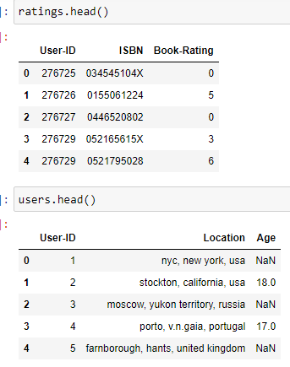
Dataset details :
There are three types of data sets in Book Recommendation System Project. These are – books, users and ratings. Here display the three datasets-

Slide 6

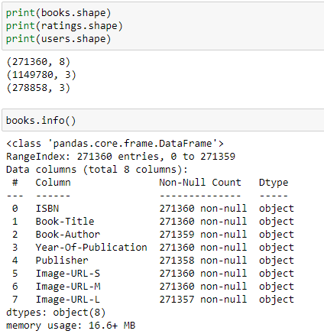
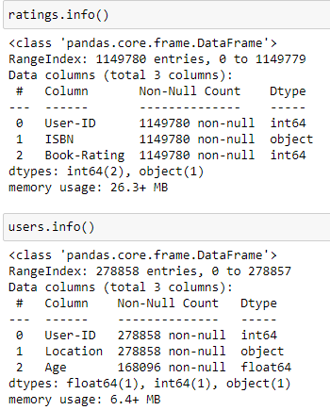
Exploratory data analysis(Eda) :
Book dataset has two lakhs seventy one thousands 3 hundred sixty rows and eight columns .
Ratings dataset has eleven lakhs forty nine thousands seven hundred eighty rows and three columns.
Users dataset has two lakhs seventy eight thousands eight hundred fifty eight rows and three columns.
Info method gives the information
about the columns , the columns are
belongs to which data-types.

Slide 7

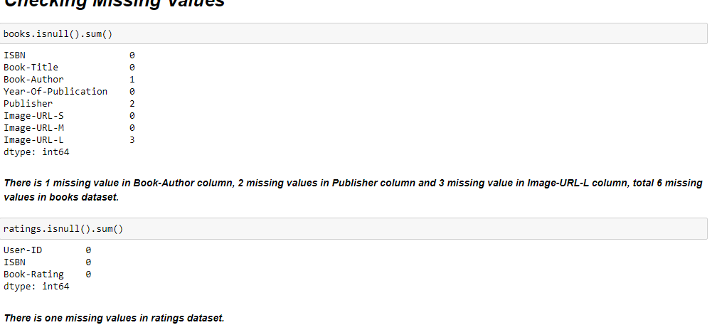
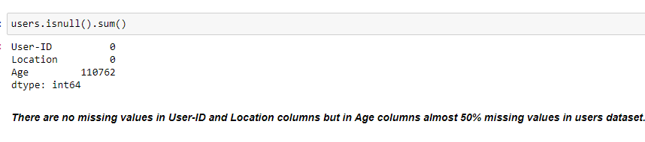
Missing values :
In book dataset , there is 1 mis-
sing value in Book-author column]
,2 missing values in Publisher
column and 3 missing values in
Image-URL-L column. So total
6 missing values in books dataset.
There is no missing values in
ratings datasets.
There is no missing values in
User-ID and Location columns
but in Age column almost 50%
missing values in users dataset.

Slide 8
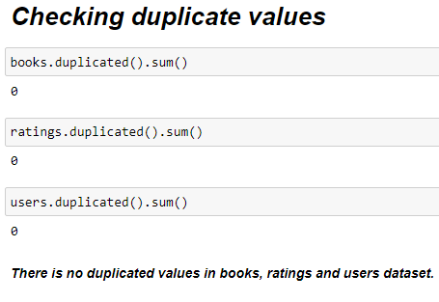
Checking duplicates values :
There is no duplicated values in books, ratings and users datasets.

Slide 9
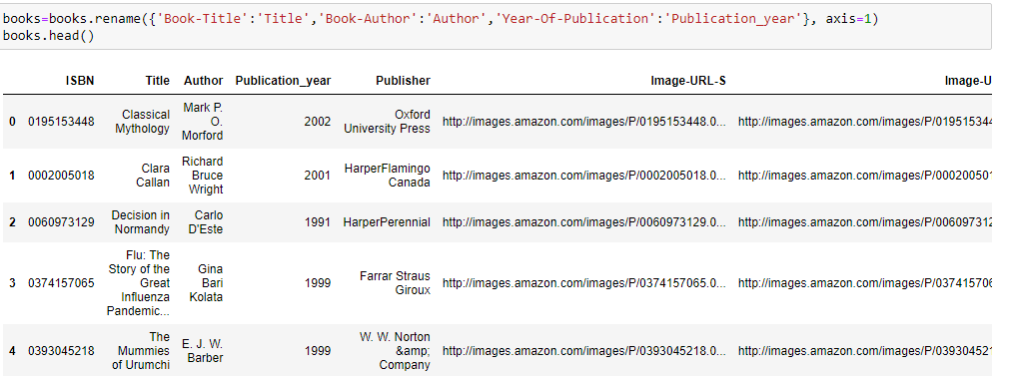
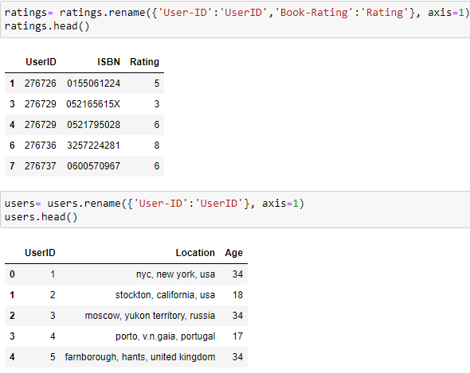
Rename columns :
Rename the columns - Book-Title to Title, Book-Author to author, Year-of-publication to Publication_year in books dataset.
Rename the columns – User-ID to UserID , Book-Rating to Rating in ratings dataset.
Rename the columns – User-ID to UserID in users dataset.

Slide 10
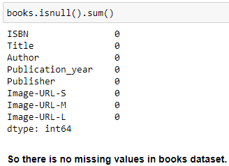
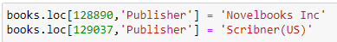
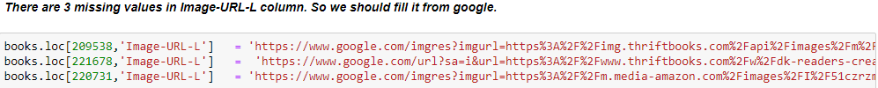
Fill the missing values :
As there are 6 missing values in books dataset ,so we have replaced
the missing values from google
After replacing values from google checking
that there is no missing
values in books dataset.

Slide 11
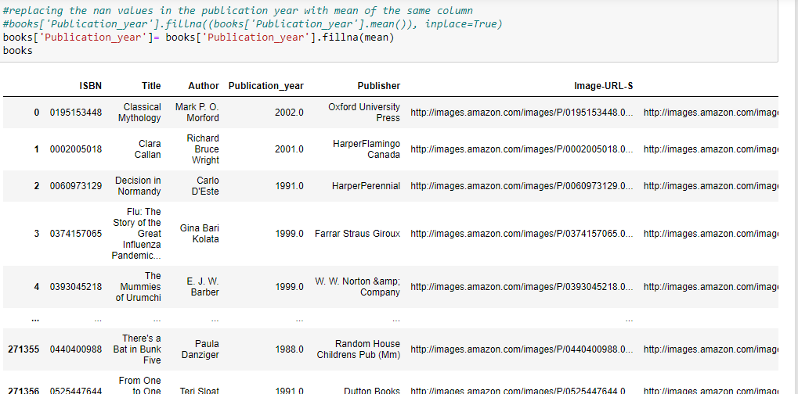
Mean Imputation :
There are many 0 values in Publication_year ocolumn in book dataset. So, we have calculated mean imputation of this column and we have replaced this 0 values to mean value.

Slide 12
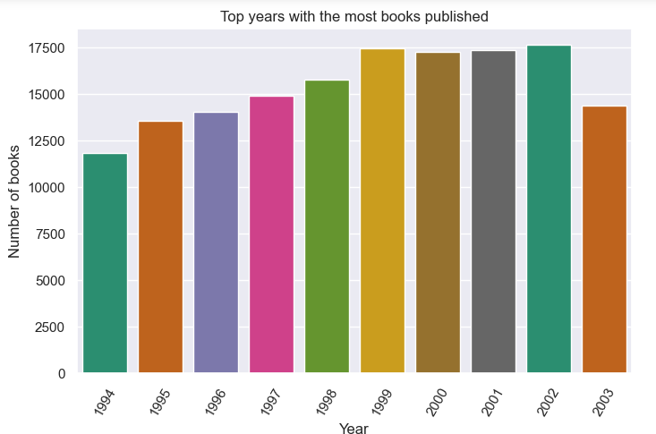
visualization :
This is the plot of Top 10 years with the most books publisher , putting year in the X-label and Number of books in the Y-label . In the year 2002 most numbers of book has published.

Slide 13
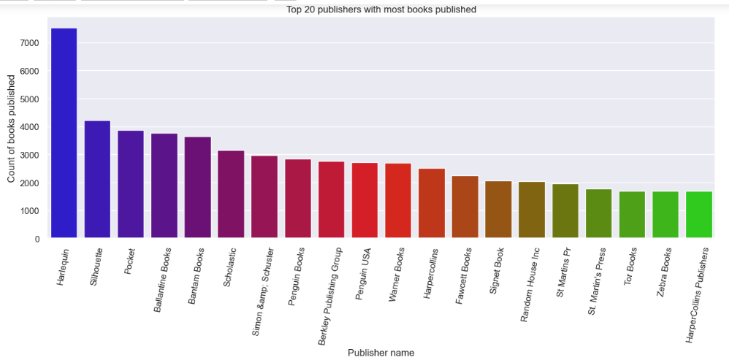
visualization :
This plot is Top 20 publishers with most books published , putting Publisher name in the X-label and Count of books published in the Y-label . Publisher Harlequin has published more than 7000 book.

Slide 14
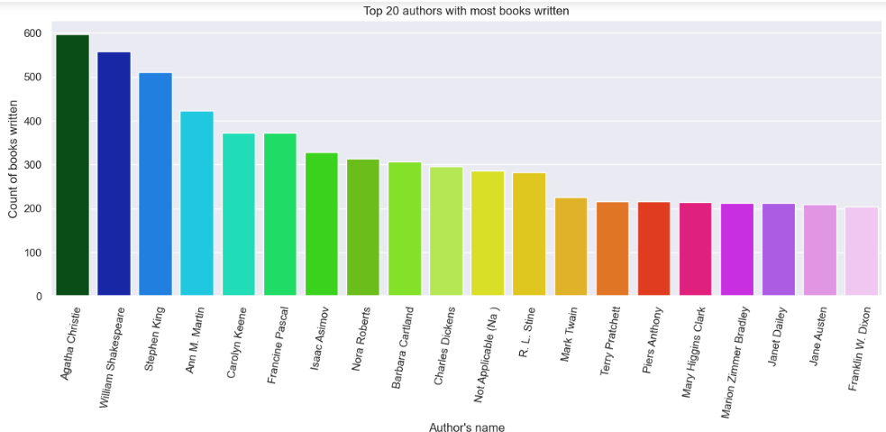
Visualization :
This is the plot of Top 20 authors with most books written , putting Author’s name in x-label and count of the book written in the y-label . Author Agatha Christie has written more than 600 books.

Slide 15
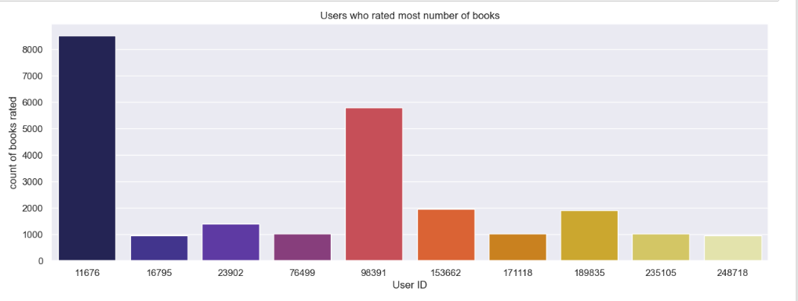
Visualization :
This is the plot of Users who rated most numbers of books , putting UserId in the X-label and count of the books rated in the Y-label . UserId 11676 has rated more than 8000 books.

Slide 16
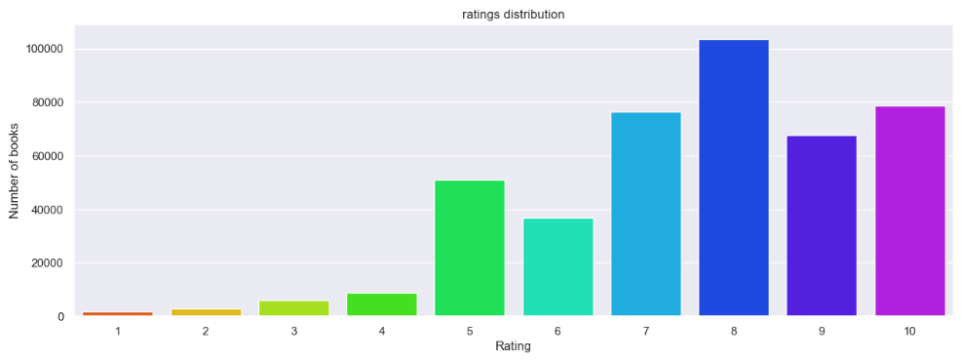
Visualization :
This is the plot of ratings distribution , putting Rating in the X-label and Number of books in the Y-labels . More than 100000 books has gotten rating 8.

Slide 17
Model Building

Slide 18

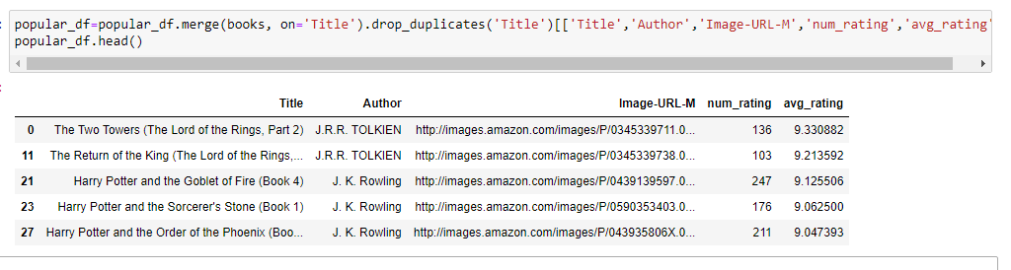
Popularity based recommender system :
This shows top 50 books with Title, Author , Image-URL-M , num_rating and avg_rating.

Slide 19


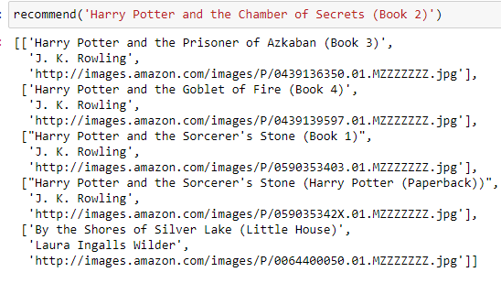
Colaborative filtering Based recommender system :
Here display five recommendation books with Author name and Image-URL-M.

Slide 20
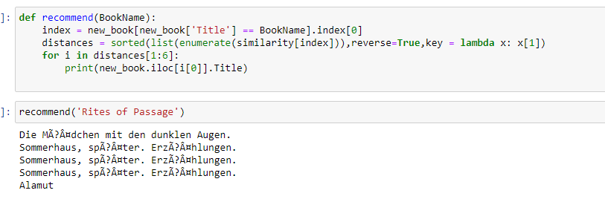
Content based recommender system :
Display 5 recommendation books.

Slide 21
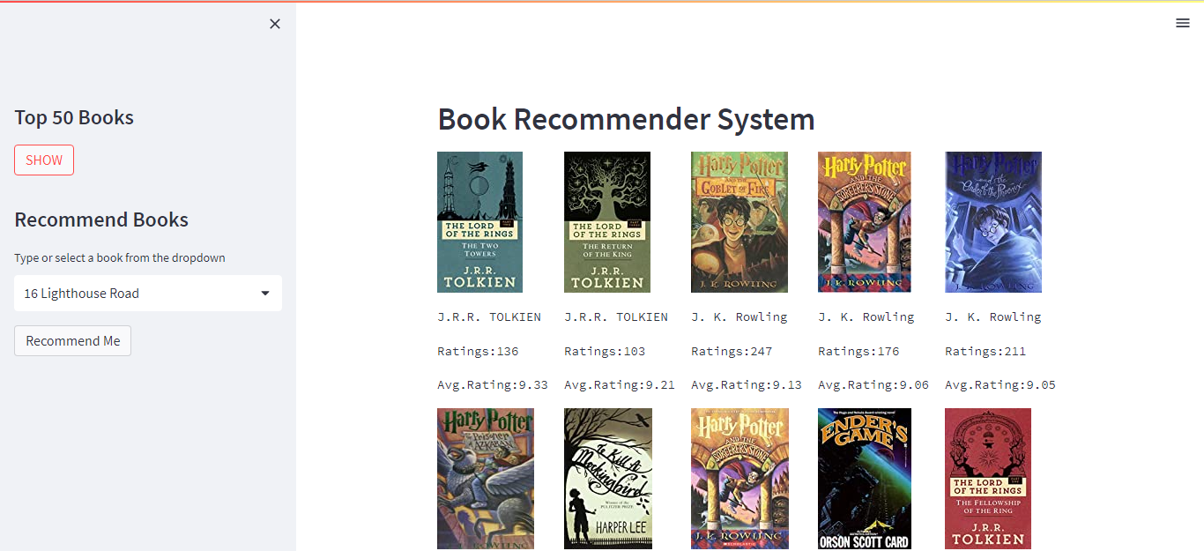
Deployment :
Display top 50 books with book title , author name ,images, avg-rating, num-rating.

Slide 22
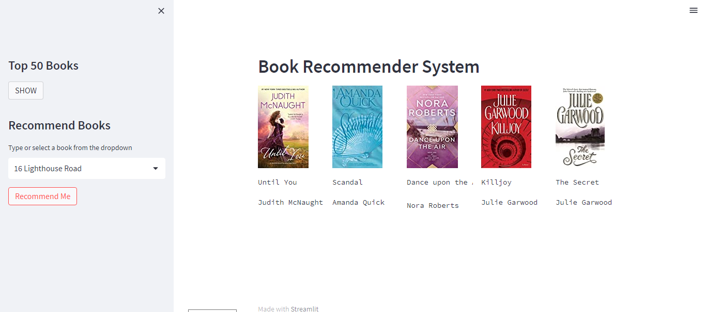
Deployment :
Recommend 5 books .

Slide 23

Challenges faced :
We faced challenges to create more than three models.
We faced challenges in the time of deployment -to run streamlit page .

Slide 24

Thank you

